Slide 1

Integer Programming
Chapter 12

Slide 2
Introduction
The integer programming (IP) problem is a restricted form of the linear programming problem
Decision variables must have integer values
The divisibility assumption does not hold
The mixed integer programming (MIP) variant
Only some of the variables must have integer values

Slide 3

Introduction
Binary integer programming (BIP)
Two possible integer values
Example: yes or no decisions
binary variables (or 0–1 variables)

Slide 4
12.1 Prototype Example
California Manufacturing Co.
Considers building new factory in Los Angeles or San Francisco, or both
Considers building one new warehouse
Choice of location restricted to city where factory is being built
Objective: find the feasible combination of alternatives that maximizes the net present value

Slide 5
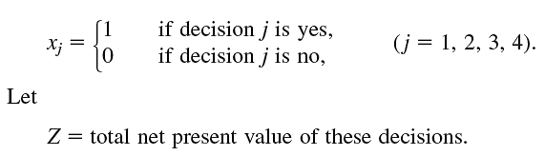
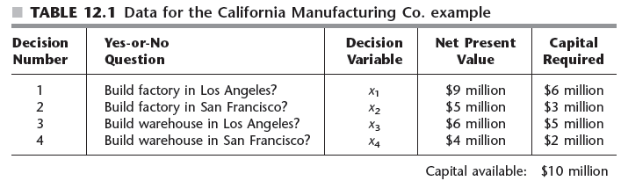
Prototype Example
Formulating the model

Slide 6
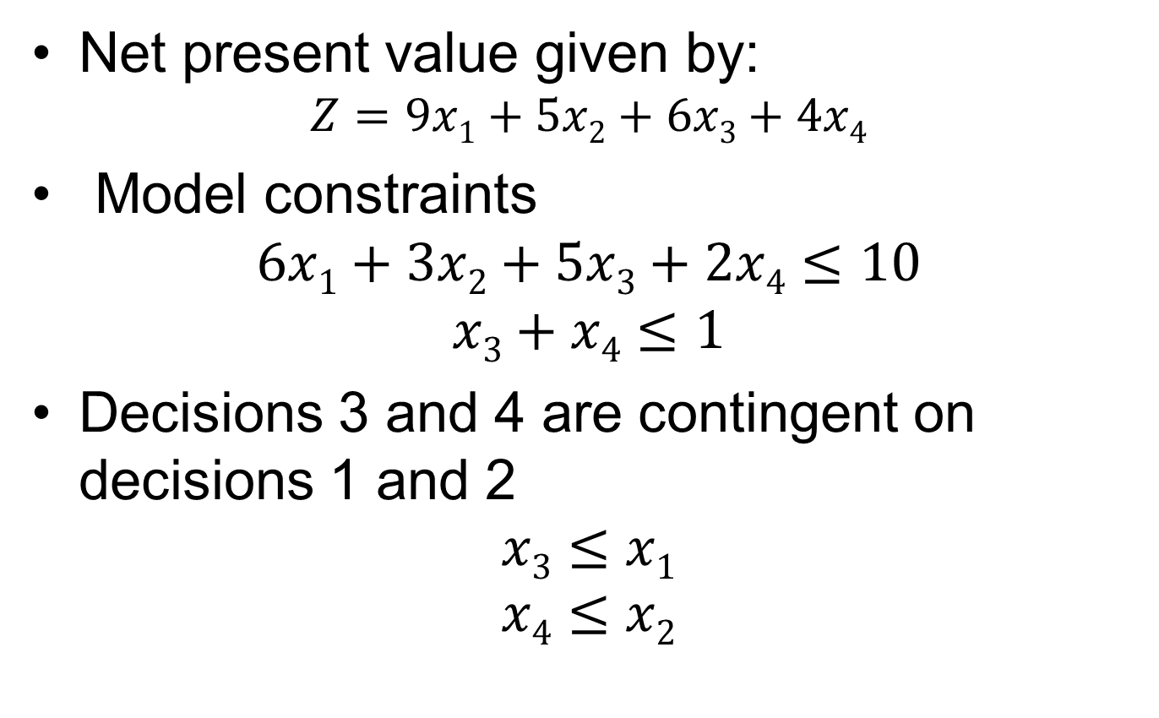
Prototype Example
Net present value given by:
$$Z=9x1+5x2+6x3+4x4$$
Model constraints
$$6x1+3x2+5x3+2x4≤10$$
$$x3+x4≤1$$
Decisions 3 and 4 are contingent on decisions 1 and 2
$$x3≤x1$$
$$x4≤x2$$

Slide 7
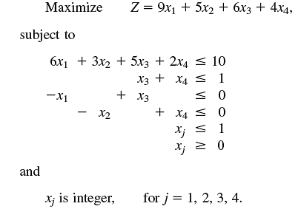
Prototype Example

Slide 8
Prototype Example
Software options for pure or mixed BIP models
Excel
LINGO/LINDO
MPL/Solvers

Slide 9
12.2 Some BIP Applications
Investment analysis
Decision: whether to invest a fixed amount
Used in capital budgeting decisions
Upgrading a nation’s defense force
Site selection
Decision: should new facility be located at the potential site?

Slide 10
Some BIP Applications
Designing a production and distribution network
Types of decisions
Should a certain plant remain open?
Should a certain site be selected for a new plant?
Should a certain distribution center remain open?
Should a certain site be selected for a new distribution center?

Slide 11
Some BIP Applications
Dispatching shipments发送运输
Decision: should a certain route be selected for one of the trucks?
Certain route
Certain size of truck
Certain time period for departure
Scheduling interrelated activities
Decision: should a certain activity begin in a certain time period?

Slide 12
Some BIP Applications
Airline applications
Decision types
Should a certain type of aircraft be assigned to a certain flight leg?
Should a certain sequence of flight legs be assigned to a crew机组人员?
Reassignment of crews to flights to adjust to weather delays, etc.

Slide 13
Exercise
工厂A₁和A₂生产某种物资。由于该种物资供不应求，故需要再建一家工厂。相应的建厂方案有A₃和A₄两个。这种物资的需求地有B₁,B₂,B₃,B₄四个。各工厂年生产能力、各地年需求量、各厂至各需求地的单位物资运费c_{ij}，见下表：
 | B1 | B2 | B3 | B4 | 年生产能力
A1 | 2 | 9 | 3 | 4 | 400
A2 | 8 | 3 | 5 | 7 | 600
A3 | 7 | 6 | 1 | 2 | 200
A4 | 4 | 5 | 2 | 5 | 200
年需求量 | 350 | 400 | 300 | 150
工厂A3或A4开工后，每年的生产费用估计分别为1200万或1500万元。现要决定应该建设工厂A3还是A4，才能使今后每年的总费用最少。

Slide 14
解：这是一个物资运输问题，特点是事先不能确定应该建A3还是A4中哪一个，因而不知道新厂投产后的实际生产物资。为此，引入0-1变量：
再设x_{ij}为由A_{i}运往B_{j}的物资数量，单位为千吨；z表示总费用，单位万元。
则该规划问题的数学模型可以表示为：

Slide 15
混合整数规划问题

Slide 16
12.3 Innovative Uses of Binary Variables in Model Formulation
Auxiliary binary variables 辅助
Can be used to represent yes or no decisions
Helps formulate the model as a pure or mixed BIP model
Either-or constraints 或约束
Introduce an auxiliary variable to make problem fit linear programming format:
Where all constraints must be satisfied

Slide 17

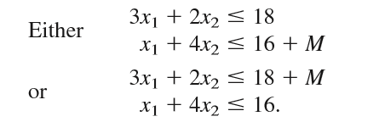

12.3 Innovative Uses of Binary Variables in Model Formulation

Slide 18
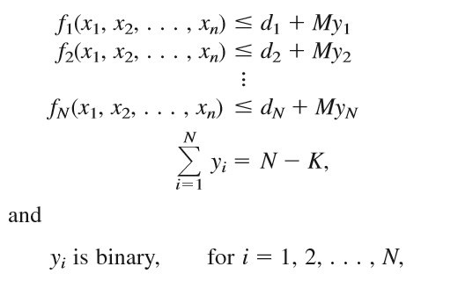
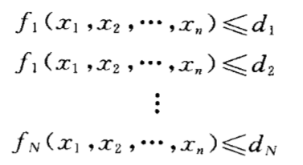
Innovative Uses of Binary Variables in Model Formulation
K out of N constraints must hold
Direct generalization of the preceding case
Introduce auxiliary variables to make problem fit the model

Slide 19
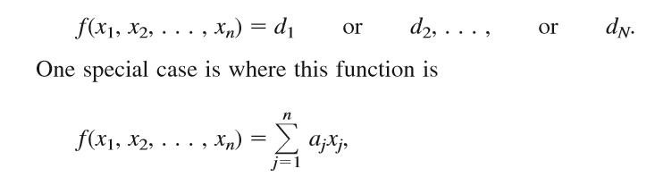
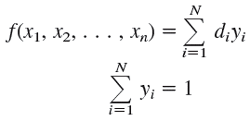

Innovative Uses of Binary Variables in Model Formulation
Functions with N possible values

Slide 20
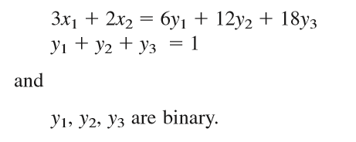
Exercise

Slide 21
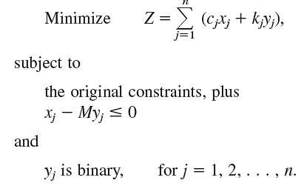
Innovative Uses of Binary Variables in Model Formulation
The fixed charge problem
Setup cost incurred to undertake an activity
Total cost equals variable cost plus fixed charge

Slide 22






Innovative Uses of Binary Variables in Model Formulation
Binary Representation of General Integer Variables

Slide 23
Innovative Uses of Binary Variables in Model Formulation
Problem with mostly binary variables and a few integer variables
Cannot directly use an efficient BIP algorithm
Substitute the binary representation for each of the general integer variables

Slide 24
12.4 Some Formulation Examples
Example 1: making choices when the decision variables are continuous
Good Products Co. has three possible new products
At most two of the three should be chosen to be produced
One of the two plants should be the sole 唯一 producer of the new product(s)

Slide 25
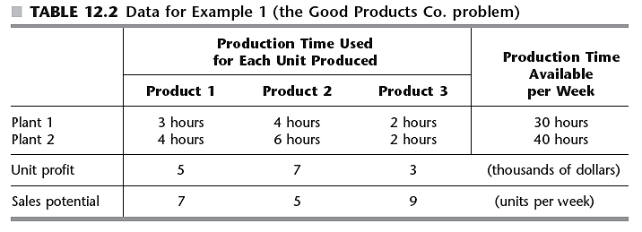
Some Formulation Examples

Slide 26
Some Formulation Examples
Example 1 problem similar to a standard product mix problem except:
The number of strictly positive decision variables (x₁, x₂, x₃) must be ≤ 2
Must introduce auxiliary binary variables
See Pages 490-492 in the text for formulation and problem solution

Slide 27
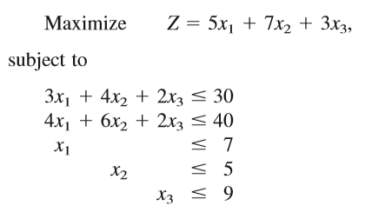

Some Formulation Examples
Let x1, x2, x3 be the production rates of the respective products

Slide 28

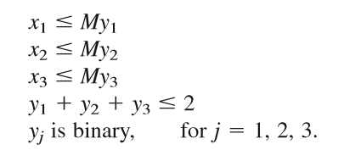

Some Formulation Examples
To deal with requirement 1
To deal with requirement 2

Slide 29
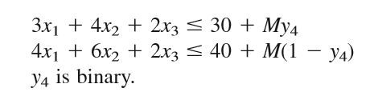
Some Formulation Examples
To deal with requirement 2

Slide 30
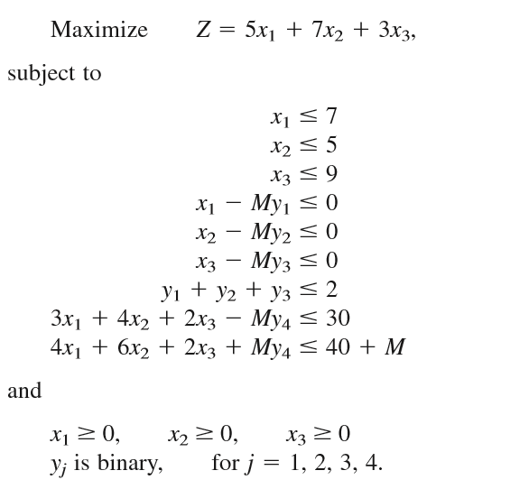
Some Formulation Examples

Slide 31
Exercise
12.1-4

Slide 32
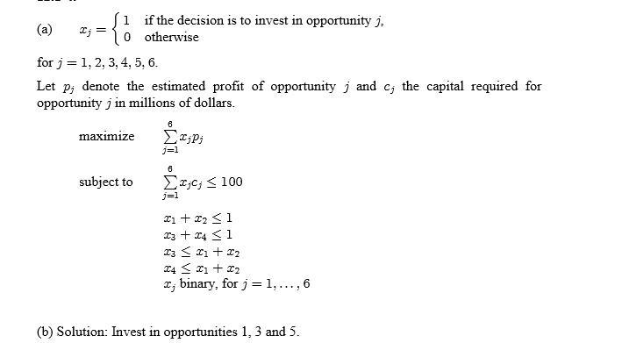
Exercise
Total Profit: 40

Slide 33
12.5 Some Perspectives on Solving Integer Programming Problems
Exponential growth of problem difficulty
Each time n is increased by one, the number of solutions doubles指数增长
Advances in BIP and linear programming algorithms as well as computing speed make solving large problems possible today
Would have taken years of computing time 25 years ago

Slide 34
Some Perspectives on Solving Integer Programming Problems
Most successful integer programming algorithms
Incorporate a linear programming algorithm
For any given IP problem:
The corresponding linear programming problem is called its “LP relaxation”LP松弛
IP problems frequently have some special structure
Can be exploited to simplify the problem

Slide 35
Some Perspectives on Solving Integer Programming Problems
Primary determinants of computational difficulty of an IP problem
The number of integer variables
Whether the variables are binary integer variables or general integer variables
Whether there is any special structure
IP problems generally more difficult to solve than linear programming problems

Slide 36
Some Perspectives on Solving Integer Programming Problems
Potential approach
Apply simplex method to LP relaxation and round the answer to the nearest integer
Approach may be adequate if variable values are quite large
Rounding will introduce only a small error
Pitfall 缺陷1: optimal linear programming solution not necessarily feasible if rounded
Pitfall 2: rounded solution may be far from the optimal integer solution

Slide 37
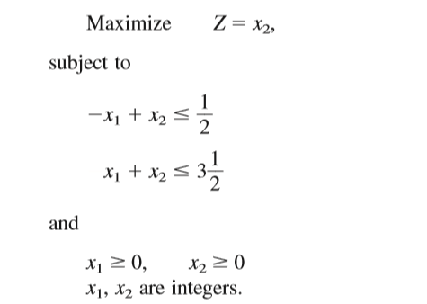

Some Perspectives on Solving Integer Programming Problems

Slide 38
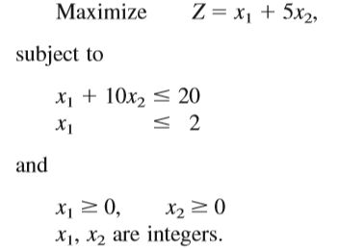
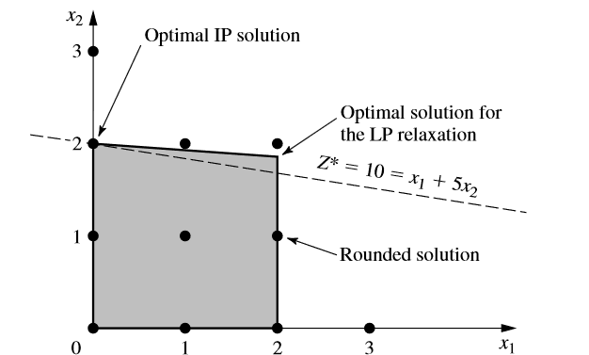
Some Perspectives on Solving Integer Programming Problems

Slide 39
Some Perspectives on Solving Integer Programming Problems
Better approach
Heuristic algorithms 启发式算法
Developing IP algorithms
An active area of research

Slide 40
12.6 The Branch-and-Bound Technique and its Application 分枝定界法
Enumeration procedure
Natural to consider due to finite number of feasible solutions
Finite number can be very large
Should be structured so that only a very few solutions are examined
Branch-and-bound technique
Basic approach: divide and conquer 拆分

Slide 41
The Branch-and-Bound Technique and its Application
Dividing (branching)
Done by partitioning the entire set of feasible solutions into smaller and smaller subsets
Conquering
Done by bounding the best solution in the subset
Discarding the subset if its bound indicates it cannot possibly contain an optimal solution
Application example and general process

Slide 42
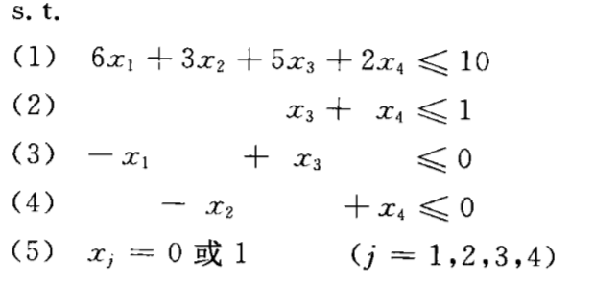
The Branch-and-Bound Technique and its Application
Application example and general process

Slide 43
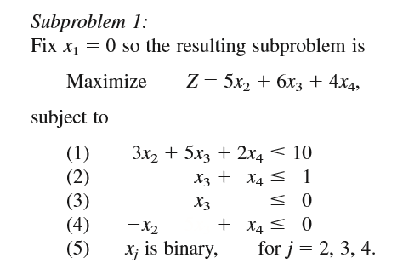
The Branch-and-Bound Technique and its Application
Branching

Slide 44
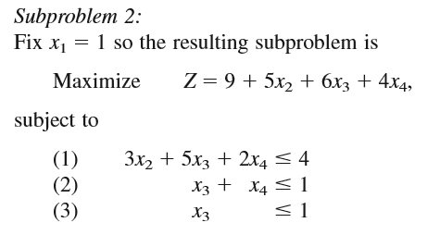

The Branch-and-Bound Technique and its Application
Branching

Slide 45
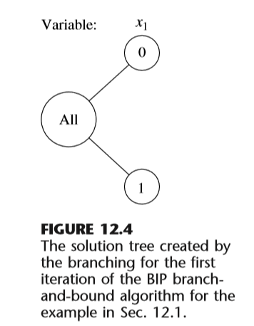
The Branch-and-Bound Technique and its Application
Branching

Slide 46



The Branch-and-Bound Technique and its Application
Bounding
Relax
simplex method

Slide 47
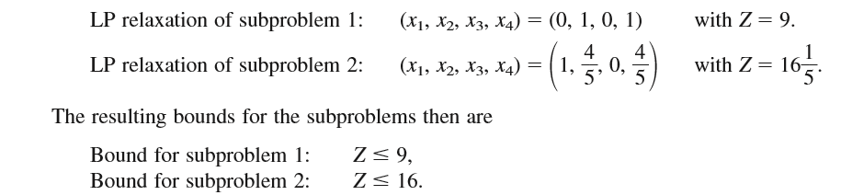
The Branch-and-Bound Technique and its Application
Bounding

Slide 48
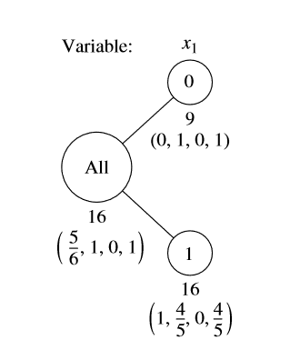
The Branch-and-Bound Technique and its Application
Bounding

Slide 49
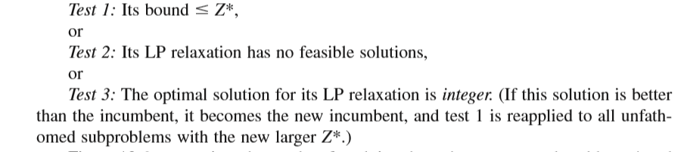
The Branch-and-Bound Technique and its Application
Fathoming剪枝

Slide 50
The Branch-and-Bound Technique and its Application
Summary of the BIP Branch-and-Bound Algorithm
Assume：
All coefficients in the objective function are integer ；
Ordering of the variables for branching is x₁, x₂, . . . , x_{n}

Slide 51
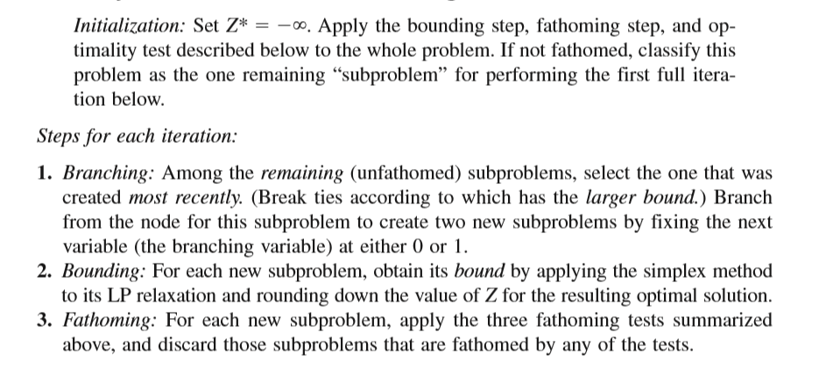
The Branch-and-Bound Technique and its Application
Summary of the BIP Branch-and-Bound Algorithm

Slide 52
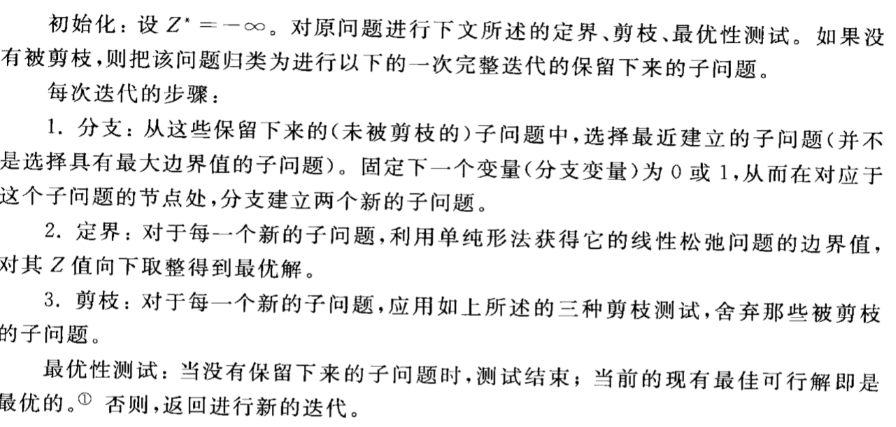
The Branch-and-Bound Technique and its Application
Summary of the BIP Branch-and-Bound Algorithm

Slide 53
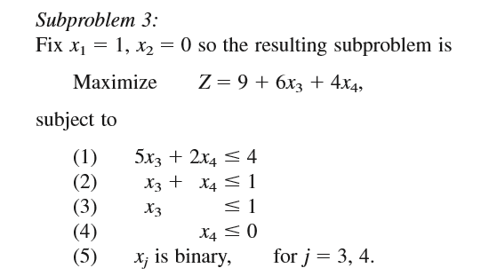
The Branch-and-Bound Technique and its Application
Example
Iteration 2.

Slide 54
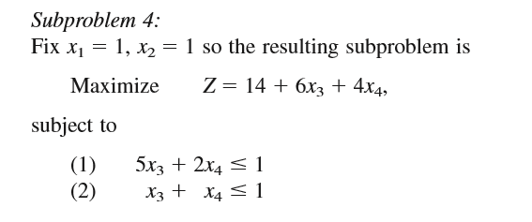
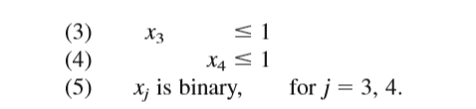
The Branch-and-Bound Technique and its Application
Example

Slide 55
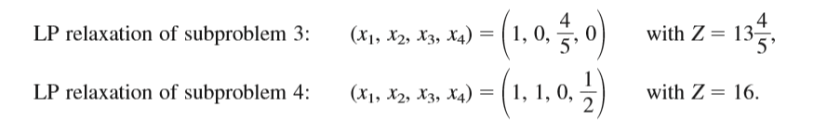
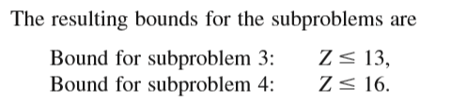
The Branch-and-Bound Technique and its Application
Example

Slide 56
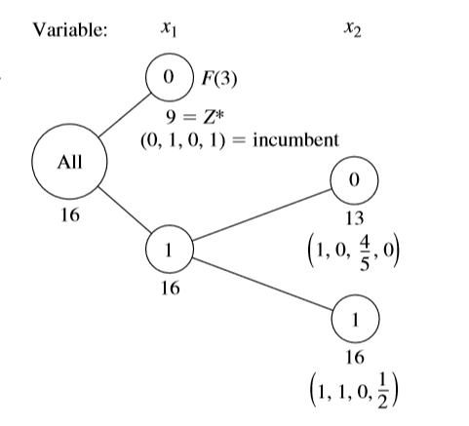
The Branch-and-Bound Technique and its Application
Example

Slide 57
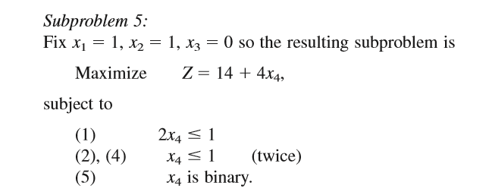
The Branch-and-Bound Technique and its Application
Example
Iteration 3

Slide 58
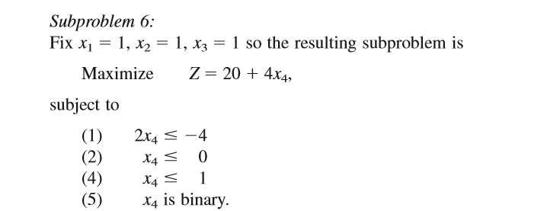

The Branch-and-Bound Technique and its Application
Example
LP relaxations by replacing constraint 5 by

Slide 59
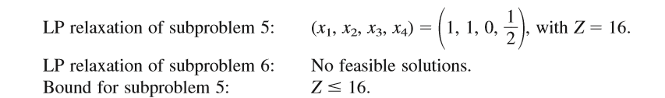
The Branch-and-Bound Technique and its Application
Example

Slide 60
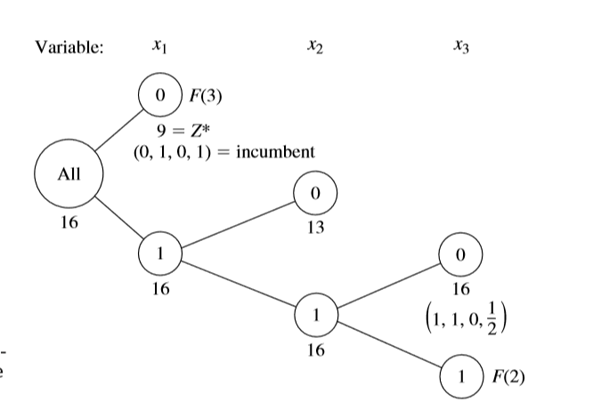
The Branch-and-Bound Technique and its Application
Example

Slide 61
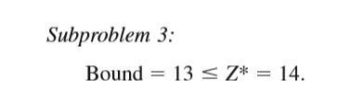
The Branch-and-Bound Technique and its Application
Example
Iteration 4.

Slide 62
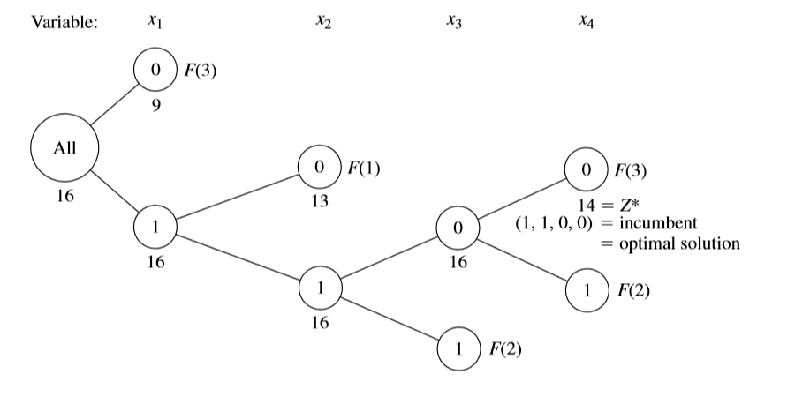
The Branch-and-Bound Technique and its Application
Example
Iteration 4.

Slide 63
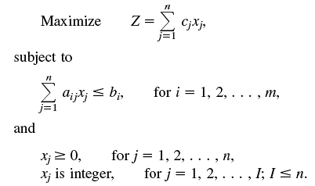
12.7 A Branch-and-Bound Algorithm for Mixed Integer Programming
Problem containing both integer and continuous variables
First I variables are integer-restricted
General form of the MIP problem

Slide 64
A Branch-and-Bound Algorithm for Mixed Integer Programming
General similarity to the BIP algorithm
Solving LP relaxations provides basis for both bounding and fathoming steps
General differences from the BIP algorithm
Choice of branching is variable
Values are assigned to the branching variable for creating new, smaller subproblems
Bounding step does not include rounding
Change to fathoming test 3

Slide 65




A Branch-and-Bound Algorithm for Mixed Integer Programming
let xj* be its (noninteger) value in the optimal solution for the LP relaxation of the current subproblem.
two new subproblems
e.g,

Slide 66
A Branch-and-Bound Algorithm for Mixed Integer Programming
Algorithmic steps
Initialization: Set Z*
Iteration
Optimality test: Stop when there are no remaining subproblems; the current incumbent is optimal. Otherwise, perform another iteration.

Slide 67
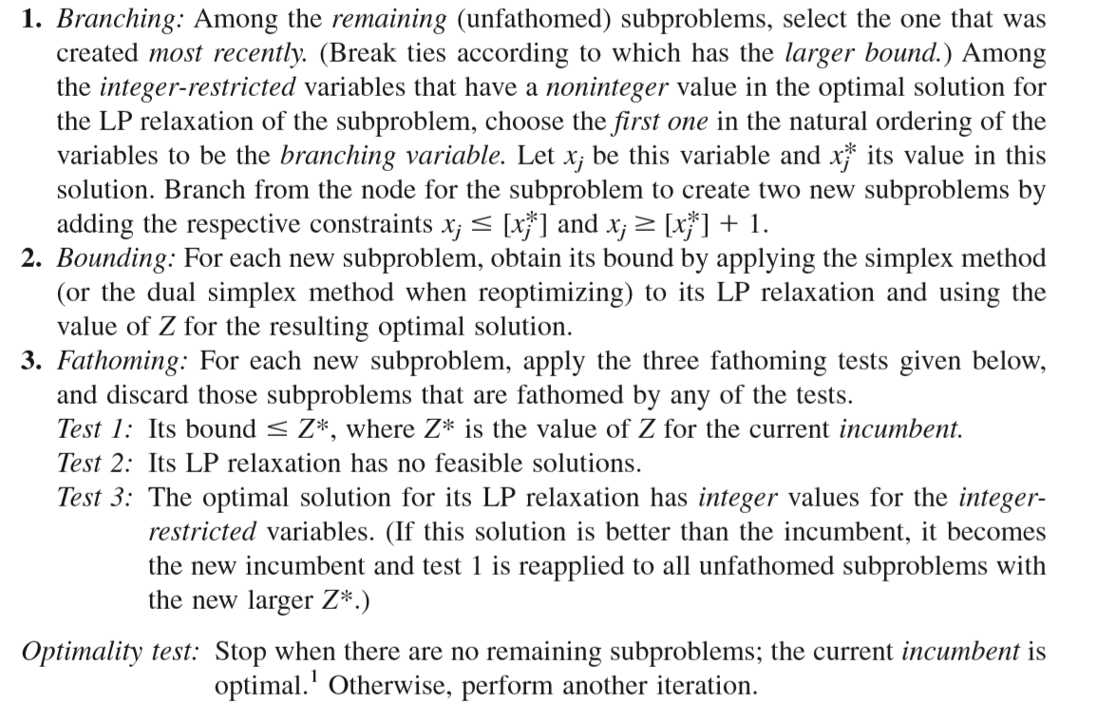

Slide 68
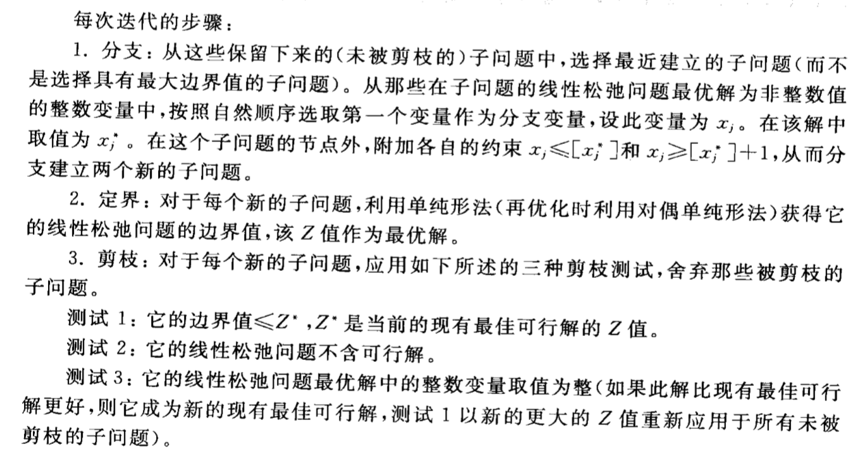

Slide 69
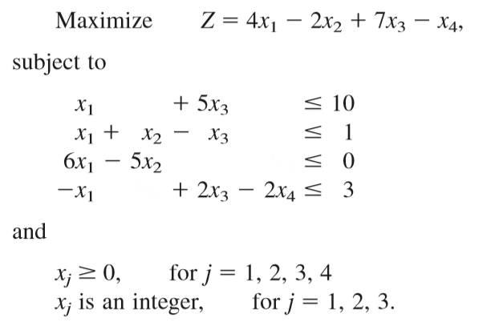
A Branch-and-Bound Algorithm for Mixed Integer Programming
Example

Slide 70

A Branch-and-Bound Algorithm for Mixed Integer Programming
Initialization

Slide 71
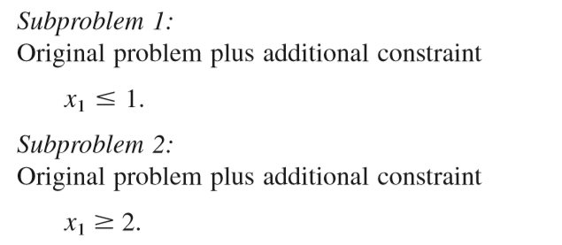
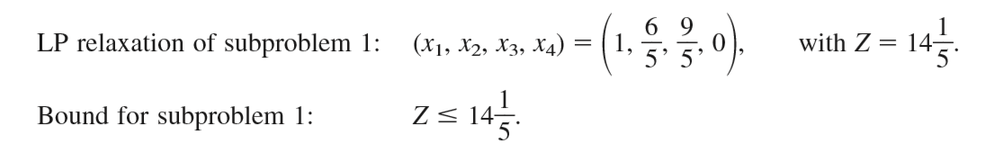
A Branch-and-Bound Algorithm for Mixed Integer Programming
Iteration 1.

Slide 72
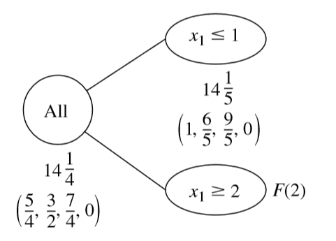
A Branch-and-Bound Algorithm for Mixed Integer Programming
Iteration 1.

Slide 73
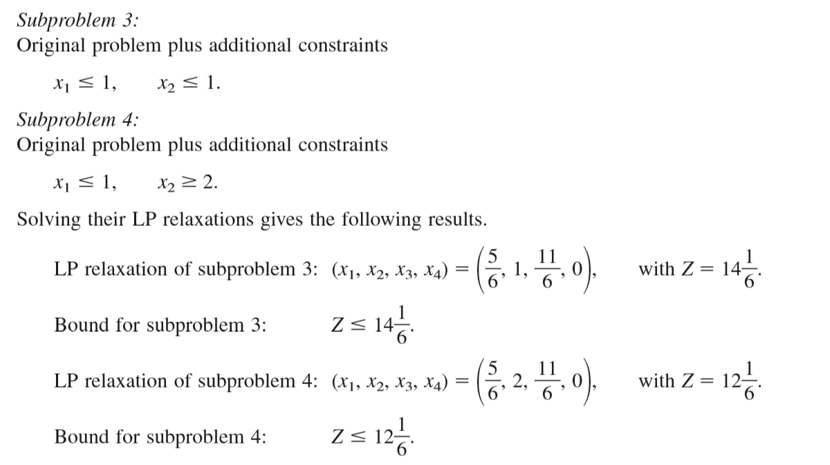
A Branch-and-Bound Algorithm for Mixed Integer Programming
Iteration 2.

Slide 74
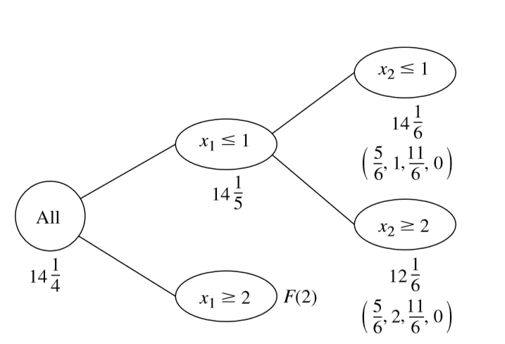
A Branch-and-Bound Algorithm for Mixed Integer Programming
Iteration 2.

Slide 75

A Branch-and-Bound Algorithm for Mixed Integer Programming
Iteration 3.

Slide 76

A Branch-and-Bound Algorithm for Mixed Integer Programming
Iteration 3.

Slide 77

A Branch-and-Bound Algorithm for Mixed Integer Programming
Iteration 3.

Slide 78
Exercise

Slide 79
Exercise
x₂
A
10
松弛问题LP0的最优解X=(3.57,7.14),Z⁰=35.7
B
C
o
10
x₁

Slide 80
Exercise
x₂
A
10
LP1:X=(3,7.6),Z¹=34.8
B
LP2:X=(4,6.5),Z²=35.5
LP1
LP2
C
o
①
②
3
4

Slide 81
Exercise
x₂
A
10
B
6
LP21:X=(4.33,6),Z₂₁=35.33
LP1
LP21
C
o
x₁
3
4

Slide 82
Exercise
x₂
A
10
LP211:X=(4,6),
Z²¹¹=34
LP212:X=(5,5),Z²¹²=35
6
LP1
LP212
C
o
x₁
3
4
5

Slide 83
上述分枝过程可用下图表示：
LP0:X=(3.57,7.14),Z₀=35.
x₁≤3
x₁≥4
LP1:X=(3,7.6)
Z₁=34.8
LP2:X=(4,6.5)
Z₂=35.5
x₂≤6
x₂≥7
LP21:X=(4.33,6)
Z₂₁=35.33
LP22
无可行解
x₁≤4
x₁≥5
LP211:X=(4,6)
Z₂₁₁=34
LP212:X=(5,5)
Z₂₁₂=35

Slide 84
12.8 The Branch-and-Cut Approach to Solving BIP Problems
Approach invented in the mid-1980s
Commonly used to solve problems with many thousands of variables
Or even hundreds of thousands
However, it cannot consistently solve all pure BIP problems
Sparsity 稀疏of the A matrix is a factor in solvability

Slide 85
The Branch-and-Cut Approach to Solving BIP Problems
Techniques used in the branch-and-cut approach
Automatic problem preprocessing自动的问题预处理
Generation of cutting planes 割平面生成
Branch-and-bound techniques
Automatic problem preprocessing
Computer inspection of the user-supplied formulation
To identify reformulations that are quicker to solve

Slide 86
The Branch-and-Cut Approach to Solving BIP Problems
Reformulation categories
Fixing variables
Eliminating redundant constraints
Tightening constraints
General principle for fixing variables
If one value of a variable cannot satisfy a certain constraint, even when other variables equal their best values for trying to satisfy the constraint
Then that variable should be fixed at its other value

Slide 87


The Branch-and-Cut Approach to Solving BIP Problems
fix x1 at x1= 0

Slide 88

The Branch-and-Cut Approach to Solving BIP Problems

Slide 89


The Branch-and-Cut Approach to Solving BIP Problems
Fixing a variable from one constraint can sometimes generate a chain reaction 连锁反应 of then being able to fix other variables from other constraints
combine one or more mutually exclusive alternatives constraints with another constraint to fix a variable

Slide 90

The Branch-and-Cut Approach to Solving BIP Problems
Eliminating Redundant Constraints
For a ≤ constraint, the most challenging binary solution has variables equal to 1 when they have nonnegative coefficients and other variables equal to 0。
For a ≥ constraint ？

Slide 91

The Branch-and-Cut Approach to Solving BIP Problems
Tightening Constraints

Slide 92

The Branch-and-Cut Approach to Solving BIP Problems
Tightening Constraints

Slide 93



The Branch-and-Cut Approach to Solving BIP Problems
Tightening Constraints

Slide 94

The Branch-and-Cut Approach to Solving BIP Problems
Tightening Constraints
Procedure for Tightening a ≥Constraint ?

Slide 95


The Branch-and-Cut Approach to Solving BIP Problems

Slide 96

The Branch-and-Cut Approach to Solving BIP Problems
12.8-5

Slide 97


The Branch-and-Cut Approach to Solving BIP Problems
Generating Cutting Planes for Pure BIP
+
X_{j} is binary

Slide 98

The Branch-and-Cut Approach to Solving BIP Problems
Generating Cutting Planes for Pure BIP

Slide 99
12.9 The Incorporation of Constraint Programming
Constraint programming
Flexible computer programming system that includes both variables and constraints on their values
While allowing the description of search procedures to generate feasible values of variables
Each variable has a domain of possible values
Great flexibility in how to state the constraints
Allows the use of standard logic functions

Slide 100
The Incorporation of Constraint Programming
Applying constraint programming to IP problems
Formulate a compact model for the problem by using a variety of constraint types
Most of which do not fit IP format
Efficiently find feasible solutions that satisfy all the constraints
Search among the feasible solutions for an optimal solution

Slide 101
The Incorporation of Constraint Programming
Potential of constraint programming
Brings computing closer to ultimate objective: user states a problem and the computer solves it
Can greatly simplify formulation of IP models
Constraint programming difficult to integrate with integer programming

Slide 102
The Incorporation of Constraint Programming
Global constraint
Constraint that succinctly expresses a global pattern in the allowable relationship between multiple variables
Examples of global constraints
All-different: all variables in a given set must have different values
The element constraint: looks up a cost or profit associated with an integer variable

Slide 103
The Incorporation of Constraint Programming
Successful applications of the merger of mathematical programming with constraint programming
Network design, vehicle routing, crew rostering, inventory management, and NFL football scheduling

Slide 104
12.10 Conclusions
IP problems
Involve some variables which must be integers
Many applications involving yes-or-no decisions
More difficult than they would be without the integer restriction
Algorithms less efficient than the simplex method
Computer codes commonly available to solve
Branch-and cut methods

Slide 105
Conclusions
Constraint programming is a relatively new area
Shows great potential in expanding the ability to formulate and solve IP models

